Slide 1
Project review-2

Slide 2
Automobile Service Center Management
Tanmay Kumar (19BCE2146)
Bhavya Sikka (19BCE0855)

Slide 3
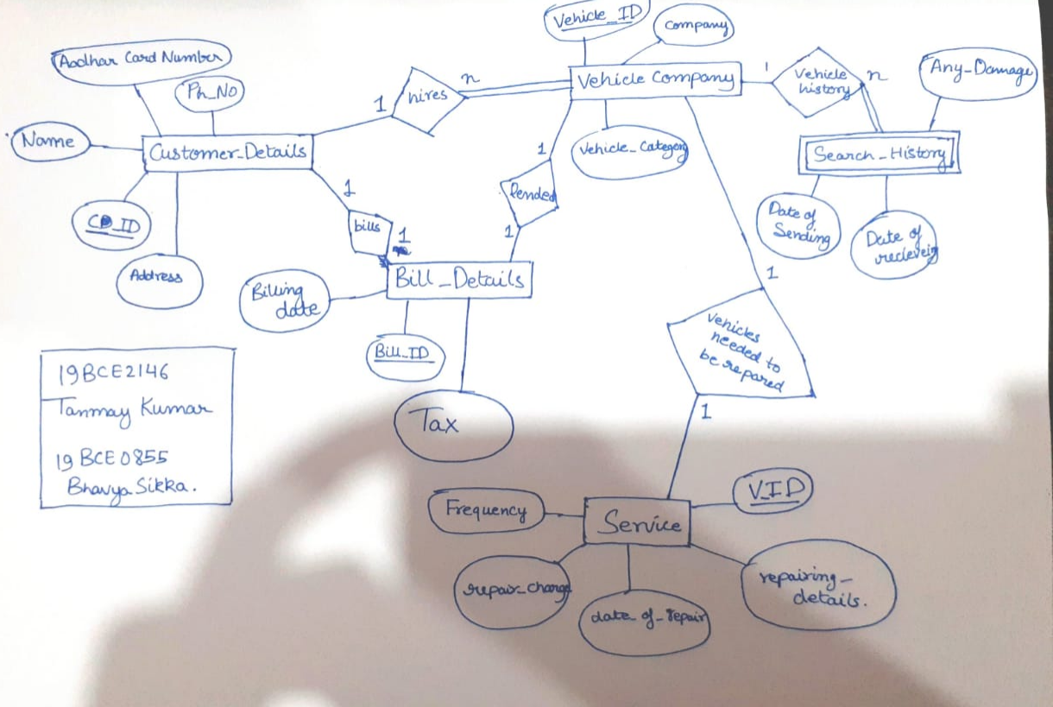
Our ER Model

Slide 4
How we are going to implement our Project:-
We are using Xampp server, which is a software distribution which provides the Apache web server, MySQL database (actually MariaDB), Php and Perl (as command-line executables and Apache modules) all in one package. It is available for Windows, MAC and Linux systems. No configuration is necessary to integrate Php with MySQL
An Intellij Idea, an integrated development environment written in Java for developing computer software.
We will use JDBC Driver to create the connection between the database and the frontend

Slide 5
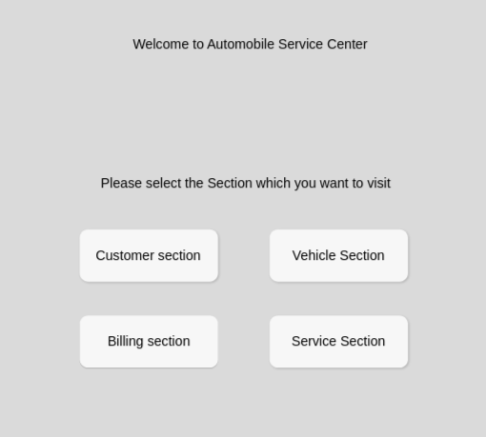
UI/UX design of Our jForm for our Project
First Page:-

Slide 6
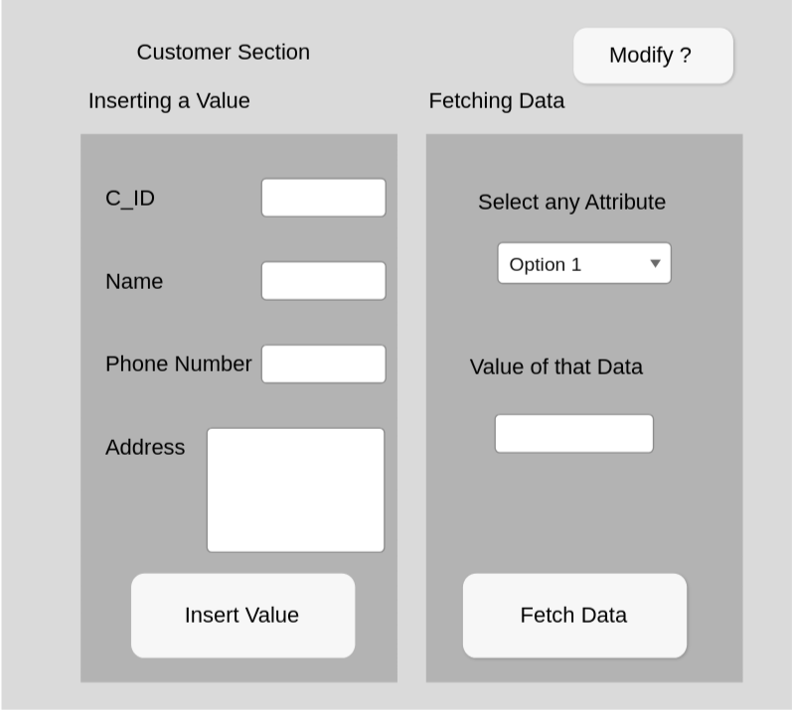
Customer Section

Slide 7
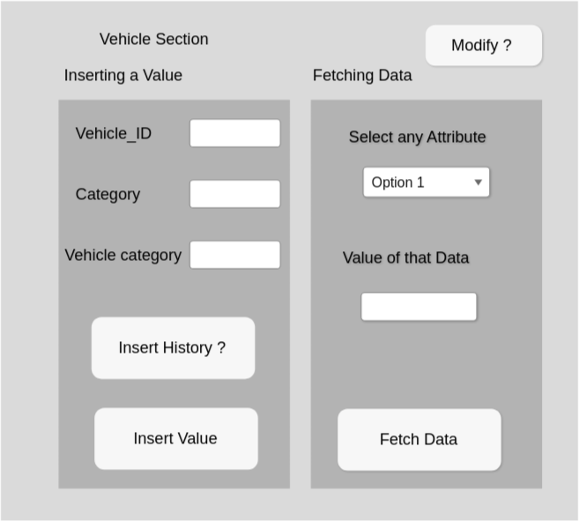
Vehicle Detail Section

Slide 8
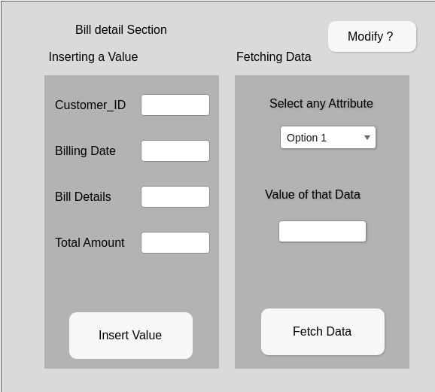
Bill Detail Section

Slide 9
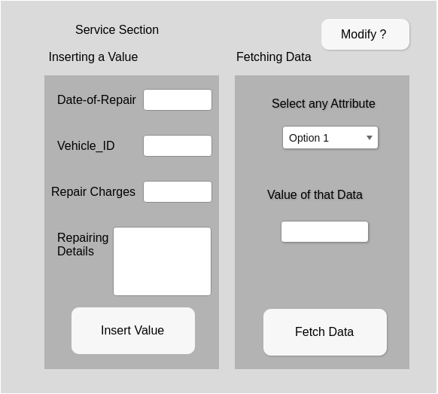
Service Section

Slide 10
In Our Backend...
We have created the Entities for all of the following sections
Customer Section
Billing Section
Vehicle Section
Service Section

Slide 11
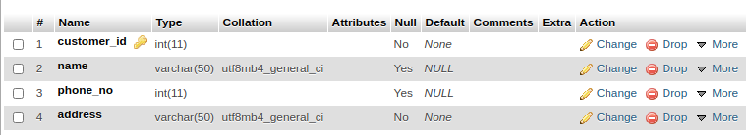
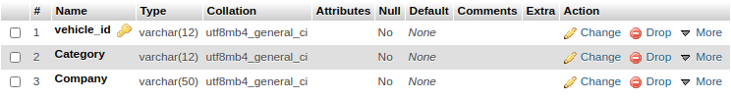
Customer Section and Vehicle Section
Customer Section
Vehicle Section

Slide 12
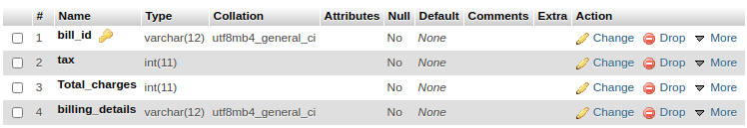
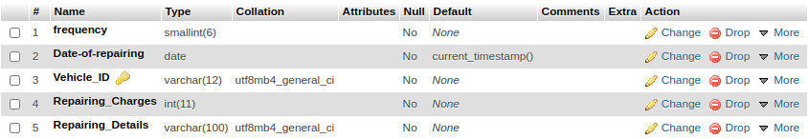
Bill Section and Service Section
Bill Details Section
Service Section

